Slide 1
Vandana Store Online Sales Annual Report 2022
Report By ~Aasif Shaikh

Slide 2
OBJECTIVE
Understand the customers behaviour and grow more sales and revenue in 2023

Slide 3
Questions to answers
Who purchased more men or women?
What are different order status?
Top 10 states contributing to the sales?
Relationship between age and gender based on no of orders
Which channel is contributing to maximum sales?
Highest selling category?
Which month got the highest sales and orders?

Slide 4
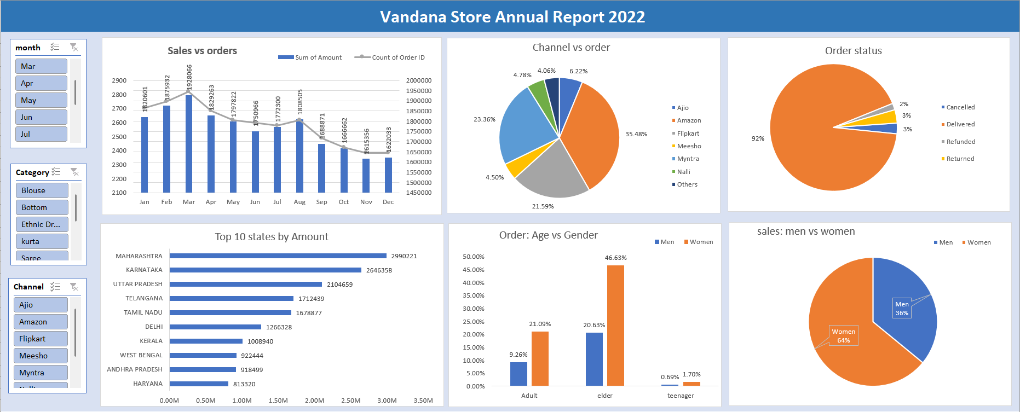
Dashboard preview

Slide 5
Insights
March got the highest sales and orders and overall Q1 performance is best throughout the year.
Amazon (35%),flipkart (21%) ,myntra (23%) contributed the most in orders.
Overall 92% orders delivered successfully which shows client statisfaction with only 3% return and 3% refund rate.
Womens are the top buyers among adult(18-35) and elder(36-45) category
Top states from revenue are Maharashtra, telangana, Karnataka,UP,etc with the Maharashtra with top 1 in the list.
The contribution of women is 64% and men is 36% in overall sales.

Slide 6
Recommendations
Targeting women customers of age group 30-45 year old in the states of Maharashtra, Karnataka, UP with targeted ads or discounts on the channels of Amazon, flipkart, myntra in the first quarter of year 2023 will lead to more sales.

